Slide 1


Predict Customer Personality to boost marketing campaign by using Machine Learning
Created by:
Muhammad Cikal Merdeka
Email : mcikalmerdeka@gmail.com
LinkedIn : linkedin.com/in/mcikalmerdeka
Github : github.com/mcikalmerdeka
Dedicated entry-level data scientist with analytical and experimental background of Physics. My graduation 2023, a pivotal year marked by significant advancements in artificial intelligence with the introduction of GPT-4 and other generative AI models, has fueled my curiosity and excitement to delve into the field of data. I have comprehensive grasp of data science methodology from business understanding to modelling process with proficiency in Python, SQL, Tableau, Power BI, Looker Studio and other tools related to data analytics workflow from several coursework and bootcamps.

Slide 2
Project Overview
A company can grow rapidly when it understands its customers' personality behavior, allowing it to provide better services and benefits to potential loyal customers. By analyzing historical marketing campaign data to improve performance and target the right customers to transact on the company's platform, our focus from these data insights is to create a predictive clustering model to facilitate decision-making for the company.
For more details, you can view the Jupyter notebook here.

Slide 3
Feature Engineering
Create new columns based on the existing columns such as :
Age : calculating the age of each customer based on their birth year and current time.
Age_Group : grouping the `age` column into category based on the distribution
Num_Child : sum the values of Kidhome and Teenhome, representing the total number of dependents or children a customer has.
Membership_Duration : duration of customer membership in year.
Total_Acc_Camp : the total number of times each customer responded to the 5 campaigns that were conducted (AcceptedCmp 1 - 5).
Total_Spending : total purchase amount of each customer across all products.
Total_Purchases : the total purchase amount of each customer across all types of transactions.
CVR (Conversion Rate) : the ratio of Total_Purchases to the Number of Web Visits for each customer. It represents the percentage of website visitors who made purchases.

Slide 4
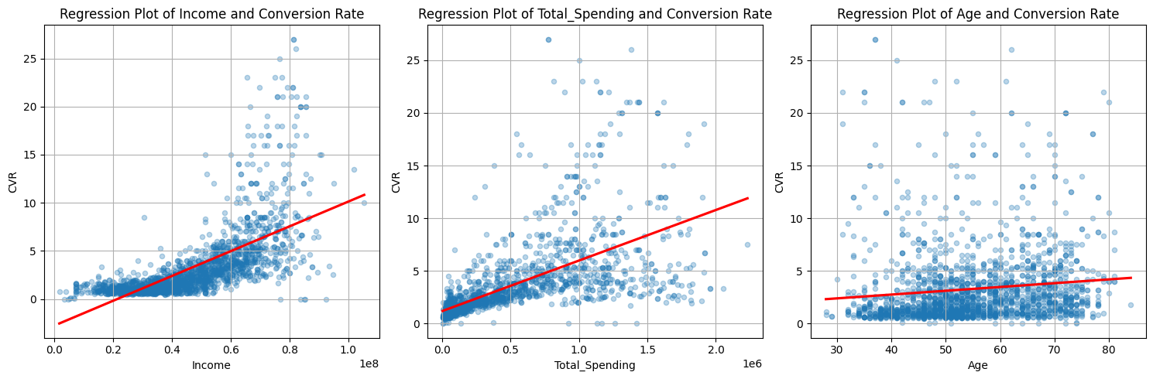
Exploratory Data Analysis (EDA)
Conversion Rate by Income, Spending, and Age
Overall, income and total spending have a positive correlation with purchase conversion rate (CVR).
This means that the higher the income and total spending, the higher the likelihood of conversion or purchase from potential consumers.
This positive correlation may be caused by several factors, such as better financial ability to meet the needs or desires of customers, as well as a high perceived value of the products or services offered. Therefore, companies can pay attention to and optimize their marketing strategies by considering target audiences with higher incomes and total spending, thereby increasing conversion opportunities and the overall success of marketing campaigns.
Meanwhile, age features tend to have a non-significant correlation with the conversion rate. This means that age is not a dominant factor influencing consumer decisions to convert or make purchases.

Slide 5
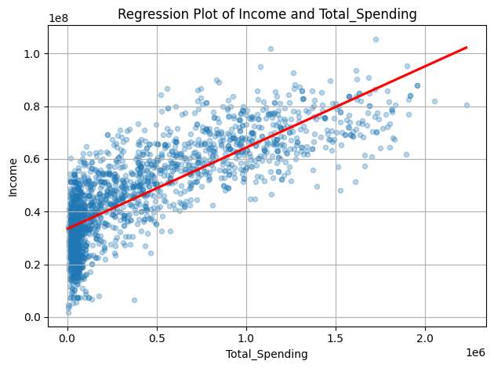
Exploratory Data Analysis (EDA)
Income and Total Spending
The strong positive correlation between income and total spending indicates a significant relationship between an individual's income level and their spending patterns. This suggests that the higher someone's income, the more likely they are to have higher expenditures.
In a business context, this understanding can help companies identify customer segments with higher purchasing potential and design appropriate marketing strategies to increase customer engagement and satisfaction.

Slide 6
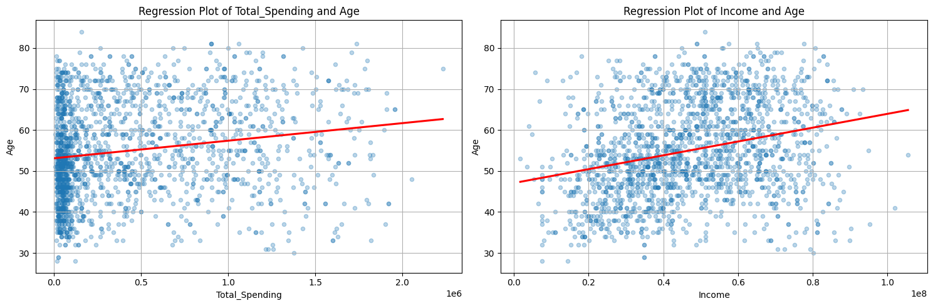
Exploratory Data Analysis (EDA)
Age by Income and Total Spending
Age has a weak positive correlation and even lacks significant correlation with the income (Income) or total spending features.
This means that age does not directly influence an individual's income level or spending patterns. However, companies still need to consider age as part of their marketing strategy. Although the weak correlation suggests that age may not be a primary determinant factor in consumer decisions.

